Slide 1
Web Service Testing
…in another way
Software Quality Assurance
Telerik Software Academy
http://academy.telerik.com

Slide 2

The Lecturer
Dimitar Topuzov
Senior QA Engineer
@NativeScript Team
Resources:
Email:
https://github.com/dtopuzov/qa-academy
Dimitar.Topuzov@Telerik.com

Slide 3

Table of Contents
Multitier architecture and software systems
The multitier architecture
Testing Web Services in context of multitier architecture
How NOT to test multitier systems
How to test multitier systems in the right way

Slide 4
Multitier Architecture
Desktop
Web
Android
iOS
UI Layer
UI Layer
UI Layer
UI Layer
Service Layer
DB Layer

Slide 5
Presentation
Multitier Architecture
UI Layer
Service Layer
Business logic
DB Layer
Data storage

Slide 6
How?
Testing Multitier Systems
UI Layer
Service Layer
DB Layer

Slide 7


Testing Multitier Systems
…in the wrong way
UI Layer
- Not testing what user actually use and see
+ Good way to test
business logic
+ Faster tests
+ Less fragile
+ Lower Maintenance
Service Layer
DB Layer

Slide 8

Testing Multitier Systems
…a bit better, but still in the wrong way
UI Layer
+ Test what the user see
- Slower
- More fragile
- Higher Maintenance
Service Layer
DB Layer

Slide 9
Testing Multitier Systems
…better, but not in the right way
UI Layer
+ Can test on both Service and UI Layer
- No way to reuse code, build and CI infrastructure, reporting tools, etc.
Service Layer
DB Layer

Slide 10


Testing Multitier Systems
…in the right way
UI Layer
Single Code Base
Utilize appropriate APIs/SDKs for accessing Service and UI Layers
Reuse Code, CI infrastructure, Reporting Tools, etc.
Service Layer
DB Layer

Slide 11
Testing Multitier Systems
…in example
System Under Test
it-ebooks.info
Automation Code Base and Ecosystem
C# and .NET
APIs for UI and Service Layers
Telerik Testing Framework
.Net HTTP Client and Json.NET

Slide 12
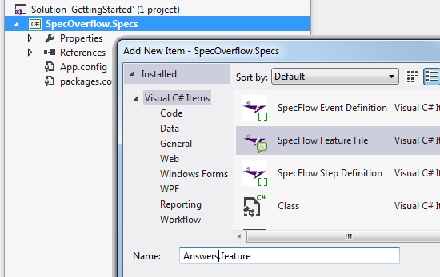
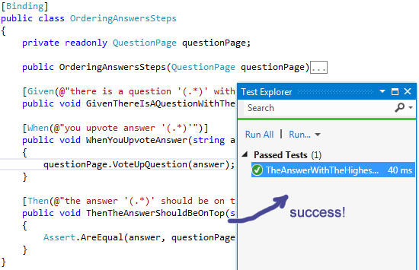
Demo
Notes:
Demos should be delivered in parallel with slides presentation.

Slide 13
Web Service Testing
?
?
?
?
?
Questions?
?
?
?
?
?
?

Slide 14




Free Trainings @ Telerik Academy
C# Programming @ Telerik Academy
csharpfundamentals.telerik.com
Telerik Software Academy
academy.telerik.com
Telerik Academy @ Facebook
facebook.com/TelerikAcademy
Telerik Software Academy Forums
forums.academy.telerik.com

